Slide 1





Transport Theory of Open Heavy Flavor in Heavy-Ion Collisions
October 8, 2015
Shanshan Cao
Lawrence Berkeley National Lab
In collaboration with G.-Y. Qin, and S. Bass

Slide 2
Outline
Introduction
Heavy flavor dynamics in QGP and Hadron Gas
Initial production: Glauber + pQCD;
In-medium evolution: an improved Langevin approach (col. + rad.)
Hadronization: a hybrid frag. + coal. model
Hadronic interaction: the UrQMD model
Heavy flavor suppression and flow (comparison with LHC/RHIC data)
Two-particle correlation functions of Heavy Flavor
Summary

Slide 3
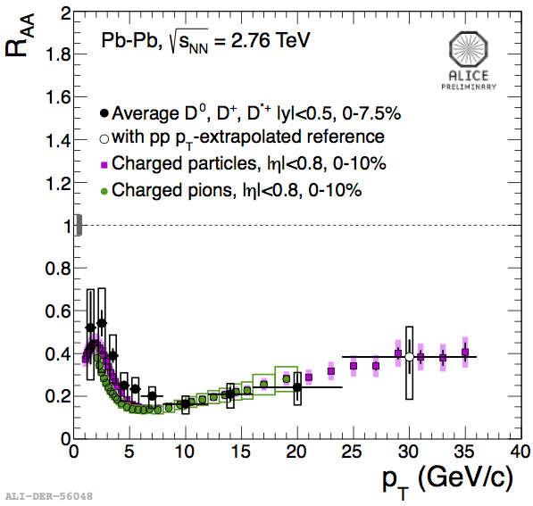
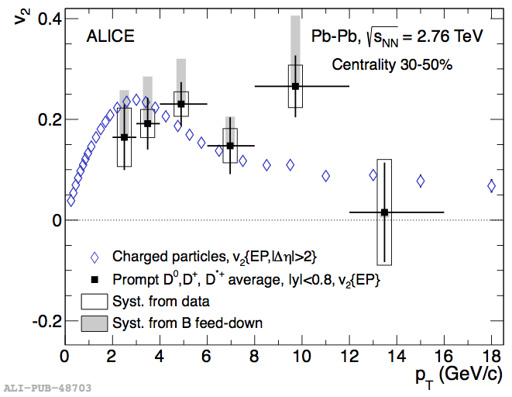
Why to Study Heavy Quarks?
Heavy → produced at early stage: probe the full QGP history
Heavy → thermal modification to mass is negligible: stable probe
Heavy → supposed to be influenced less by the medium
Large suppression and flow that are comparable to light hadrons!
“Heavy flavor puzzle”: is ΔE_{g}> ΔE_{q}> ΔE_{c}> ΔE_{b} still right?
Challenge: fully understand heavy flavor dynamics – whole evolution

Slide 4
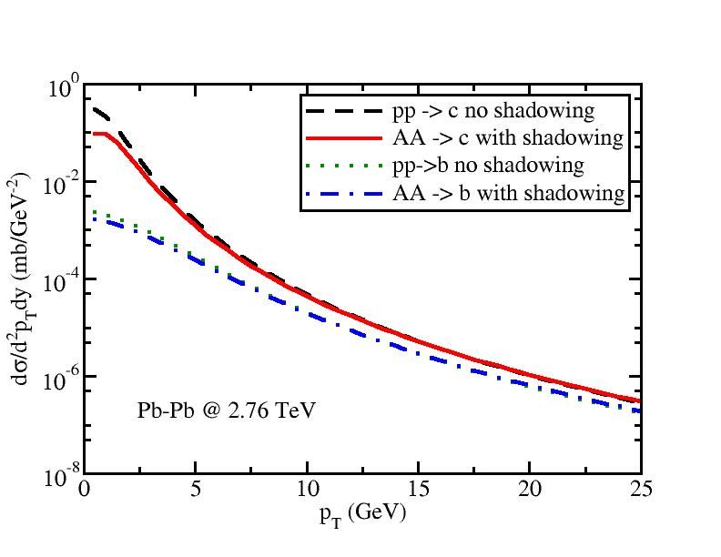
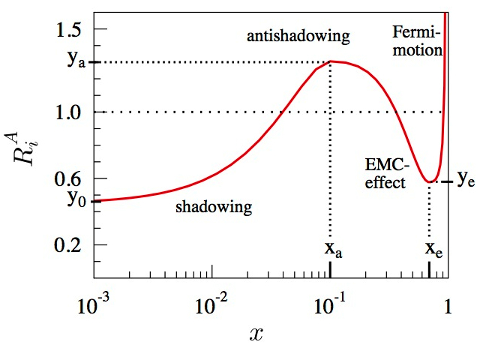
Heavy Flavor Initial Production
Initial production: MC-Glauber for the position space and LO pQCD calculation (Combridge,1979) for the momentum space
Parton distribution functions: CTEQ5 (Lai, 2000)
Nuclear shadowing effect: EPS09 (Eskola, 2009)
(Taken from Eskola 2009)
Significant shadowing effect for heavy quark production at low p_{T} (especially at the LHC energy) → impact on R_{AA}

Slide 5
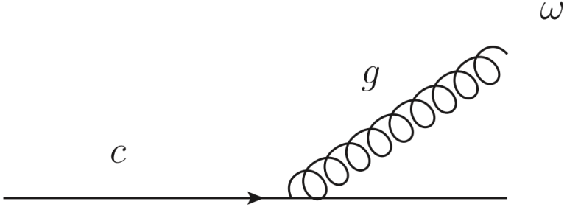
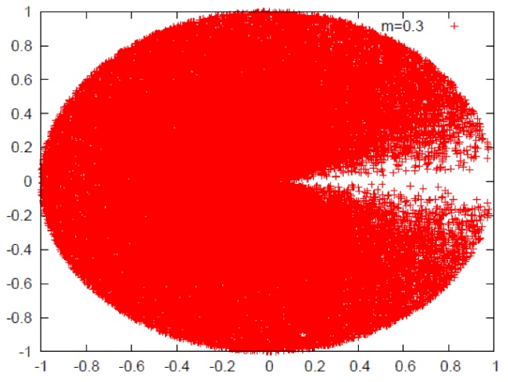
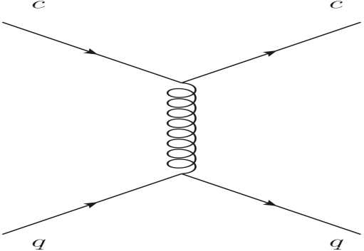
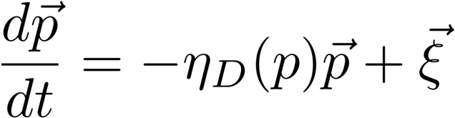
Energy Loss Mechanisms
Two ways for heavy quarks to lose energy:
Abir et al. PLB 715 183
c
collisional
c
radiative
g
θ
q
q
medium
“Dead cone effect”: Unless in an ultrarelativistic limit, gluon radiation is suppressed by the large mass of heavy quark
→ consider collisional energy loss as the dominant factor
Heavy quark inside QGP medium: Brownian motion
Description: Langevin equation

Slide 6
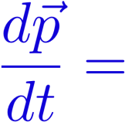



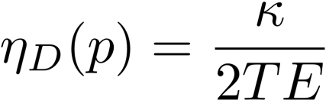
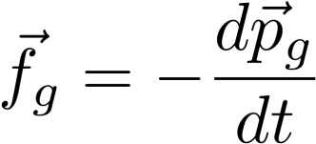
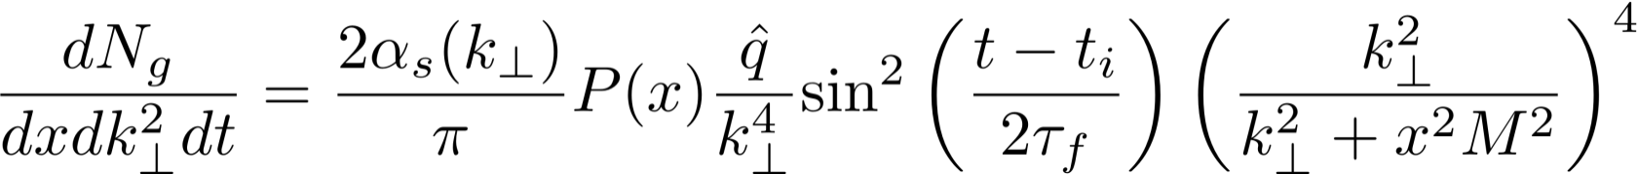
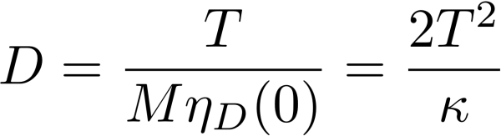

Heavy Flavor Evolution inside QGP
( Improved Langevin Approach )
Modified Langevin Equation:
Fluctuation-dissipation relation between drag and thermal random force:
Force from gluon radiation:
Gluon distribution taken from Higher Twist calculation:
Guo and Wang, PRL 85, 3591; Majumder, PRD 85, 014023; Zhang, Wang and Wang, PRL 93, 072301.
Transport Coefficients:

Slide 7
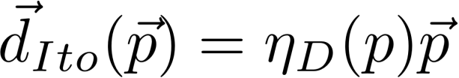
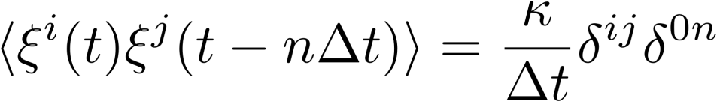

Heavy Flavor Evolution inside QGP
( Improved Langevin Approach )
Numerical Implementation (Ito Discretization)
Drag force:
Thermal random force:
Momentum of gluon radiated during Δt:
Lower cut for gluon radiation: πT
Balance between gluon radiation and absorption
Guarantee equilibrium after sufficiently long evolution

Slide 8
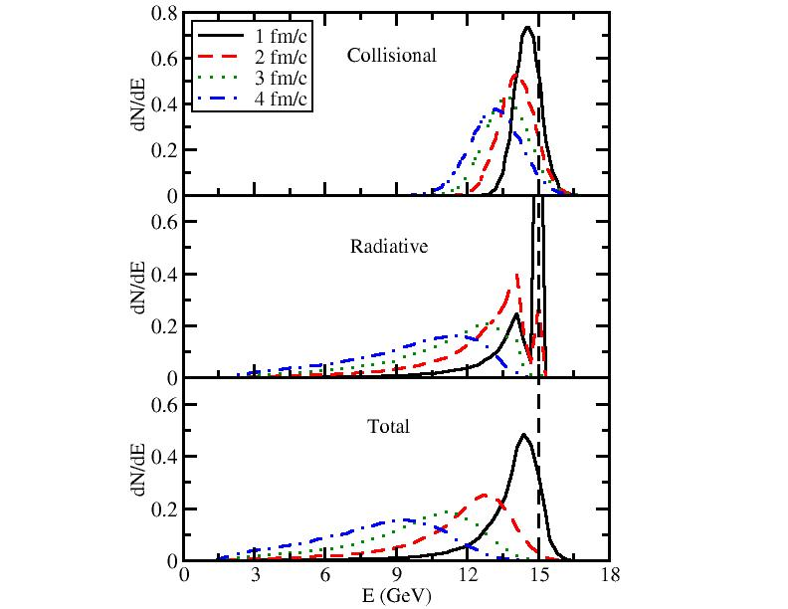
Charm Quark Evolution in Static Medium
T = 300 MeV, D=6/(2πT), i.e., qhat ~ 1.3 GeV²/fm
E_{init} = 15 GeV
z
Evolution of E distribution
Before 2 fm/c, collisional energy loss dominates; after 2 fm/c, radiative dominates;
Collisional energy loss leads to Gaussian distribution, while radiative generates long tail.

Slide 9
Charm Quark Evolution inside the QGP
Generation of QGP medium: 2D viscous hydro from OSU group (thanks to Qiu, Shen, Song, and Heinz)
Initialization of heavy quarks: MC-Glauber for position space and pQCD calculation for momentum space
Simulation of heavy quark evolution: the improved Langevin algorithm in the local rest frame of the medium
Hadronization and hadronic scattering (discuss later)
D=5/(2πT), i.e., qhat around 3 GeV²/fm at initial temperature (around 350~400 MeV)
outside the medium
(below T_{c})
hadronize and hadronic scattering

Slide 10
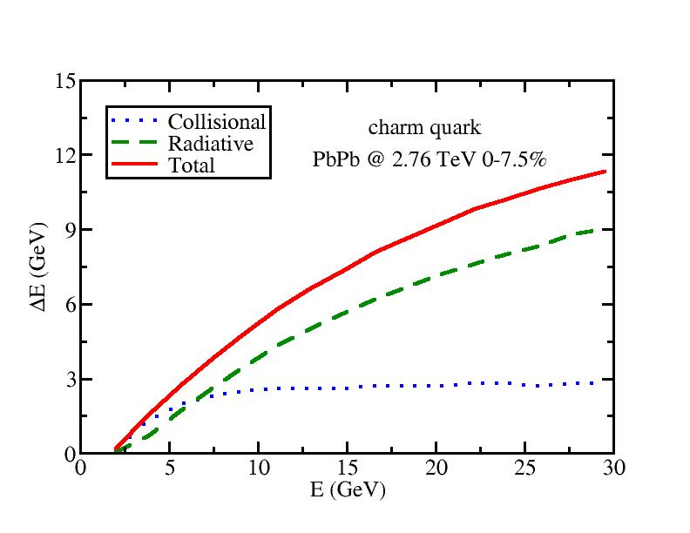
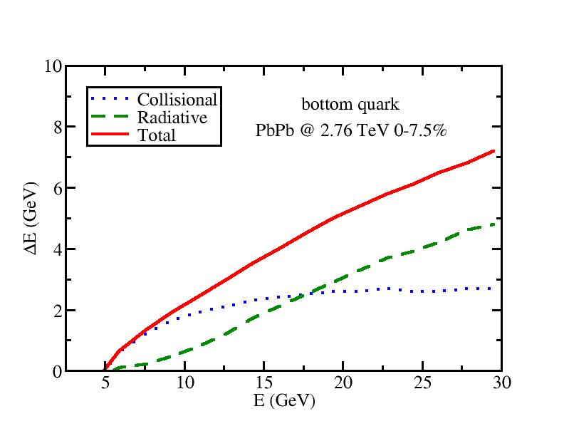
Heavy Quark Energy Loss
Collisional energy loss dominates low energy region, while radiative dominates high energy region.
Crossing point: 7 GeV for c and 18 GeV for b quark.
➔ Collisional energy loss alone may work well to describe previous RHIC data but is insufficient for LHC.

Slide 11
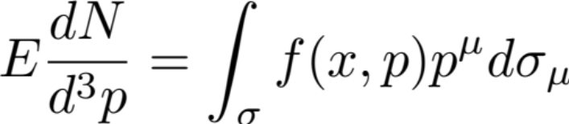
Hadronization
QGP: Cooper-Frye Freeze-out (OSU iSS)
f(x,p): thermal distribution of soft hadrons
σ: hypersurface of freeze-out
HQ: Fragmentation + Recombination
Most high momentum heavy quarks fragment into heavy mesons: use PYTHIA 6.4
Most low momentum heavy quarks hadronize to heavy mesons via recombination (coalescence) mechanism: use the instantaneous coalescence model (Oh, 2009)

Slide 12
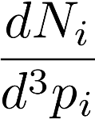

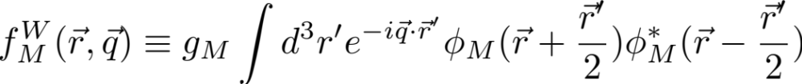

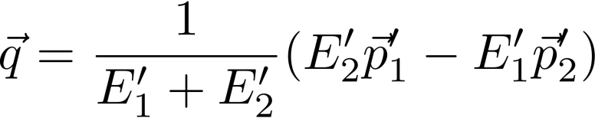
The Instantaneous Coalescence Model
Two-particle recombination:
Distribution of the i ^{th} kind of particle
Light parton: thermal in the l.r.f of the hydro cell
Heavy quark: the distribution at T_{c} after Langevin evolution
Probability for two particles to combine
Variables on the R.H.S. are defined in the c.m. frame of the two-particle system.

Slide 13
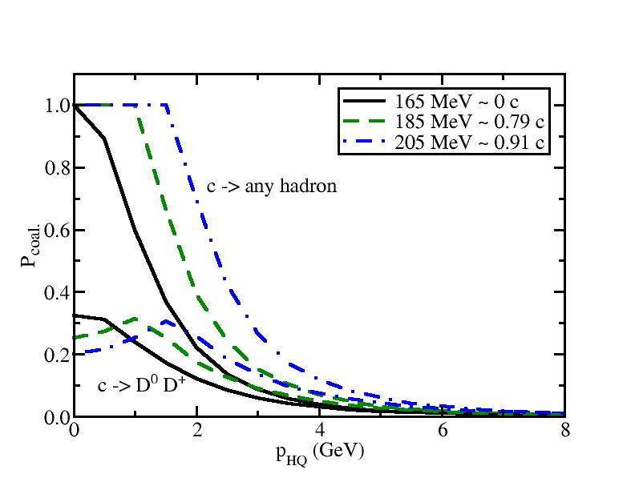
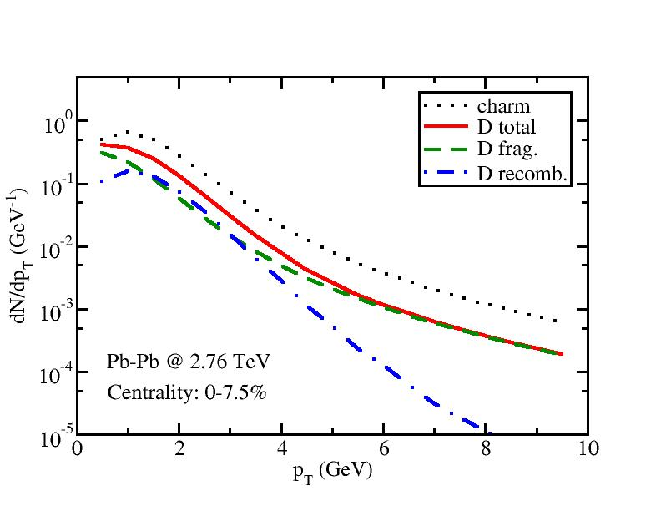
The Hybrid Coal. + Frag. Model
Use f ^{W} to calculate P_{coal.}(p_{HQ}) for all channels (D/B Λ Σ Ξ Ω) and v_{cell}
Normalization: P_{coal.}(p_{HQ}=0) =1 at T_{c} = 165 MeV and v_{cell} = 0
Use Monte-Carlo to determine the hadronization channel of each HQ: frag. or recomb.? recomb. to D/B or a baryon?
Fragmentation dominates D meson production at high p_{T}.
Recombination significantly enhances the D meson spectrum at intermediate p_{T}.

Slide 14
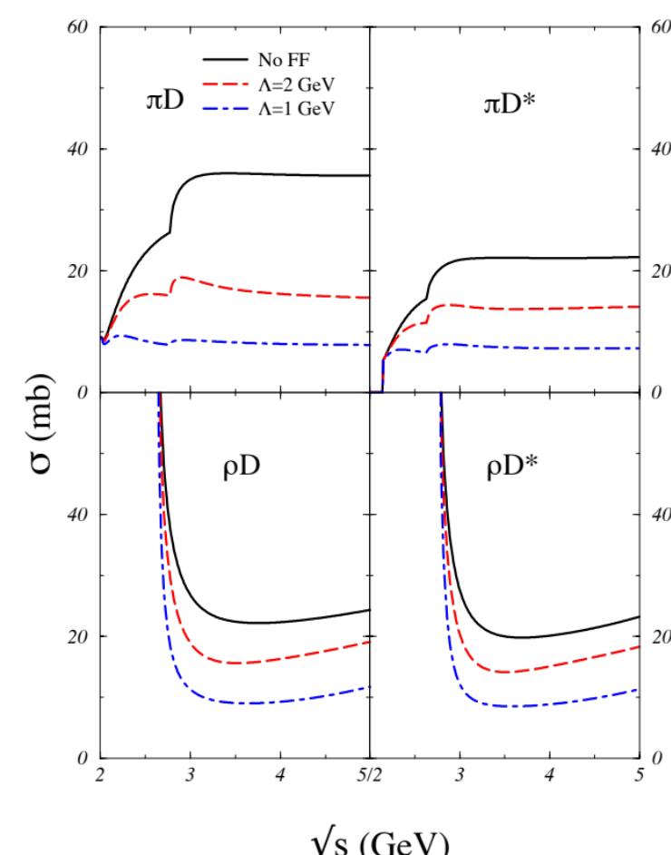
Hadronic Interactions
Soft hadrons from QGP
UrQMD
Heavy mesons from heavy quarks
Charm Meson Scattering
Cross Sections:
(Lin and Ko, 2001)
Consider scatterings with π and ρ mesons
Λ: cutoff parameter in hadron form factors

Slide 15
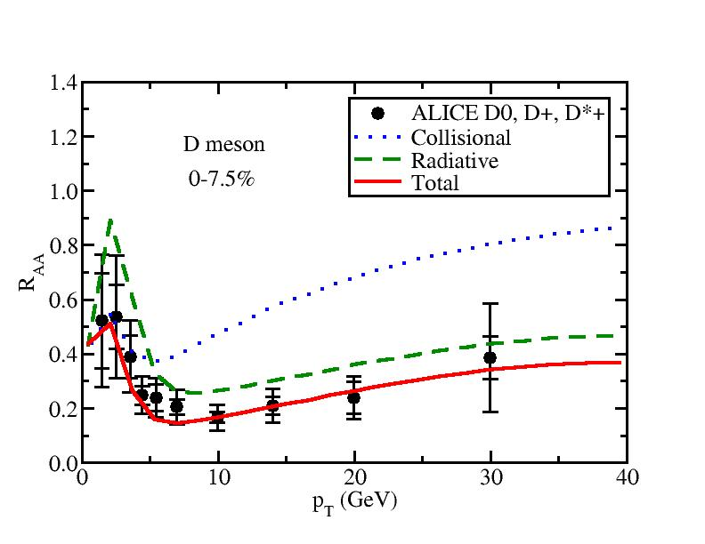
R_{AA} of LHC D meson
Collisional dominates low p_{T}, radiative dominates high p_{T}.
The combination of the two mechanisms provides a good description of experimental data.

Slide 16
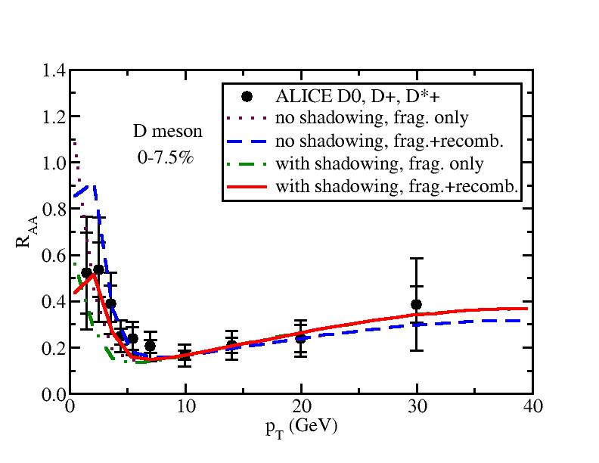
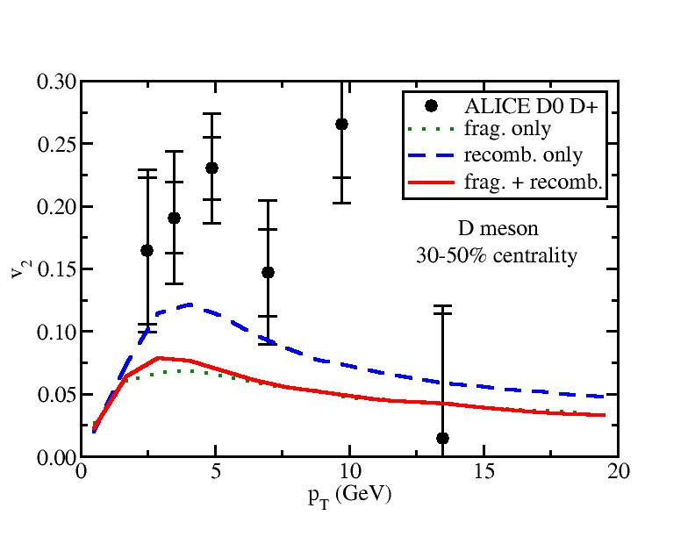
R_{AA} and v₂ of D mesons
Shadowing effect reduce R_{AA} significantly at low p_{T}.
Recombination mechanism raise R_{AA} at medium p_{T}.
Coalescence provides larger v₂ than fragmentation since it adds the p-space anisotropy of light partons to heavy quarks.

Slide 17
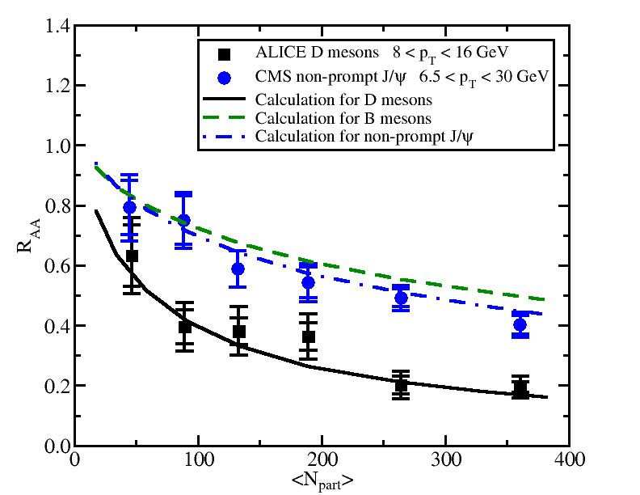
R_{AA} of D, B mesons and non-prompt J/ψ
Good description of N_{part} dependence of the D meson R_{AA}
With the same transport coefficient for c and b quarks, reasonable description of the non-prompt J/ψ R_{AA}
Mass hierarchy of heavy quark energy loss: ΔE_{c}> ΔE_{b}

Slide 18
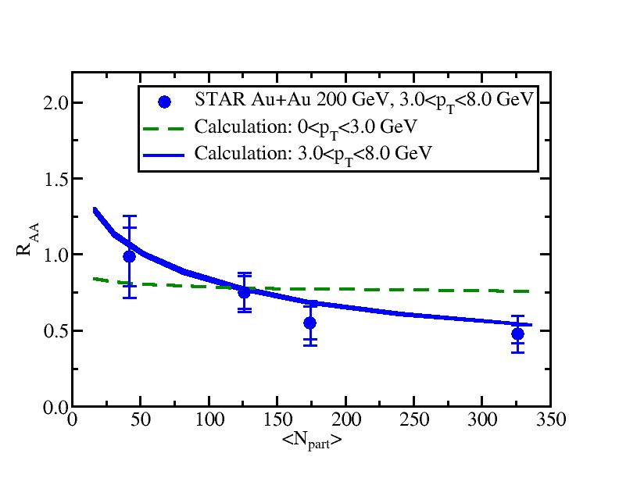
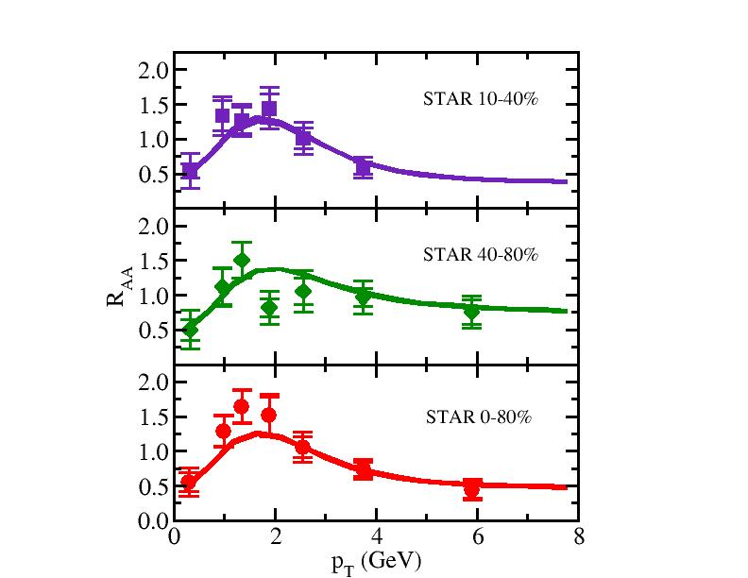
More R_{AA} results for RHIC
Centrality and participant number dependence are also consistent with RHIC observations.

Slide 19
From Single Particle Spectra to Two-Particle Correlations
( arXiv: 1505:01869 )
Δθ
At LO: Back-to-back production of initial QQbar with the same magnitude of momentum
Angular correlation function between heavy flavor pairs
Momentum imbalance between heavy flavor pairs

Slide 20
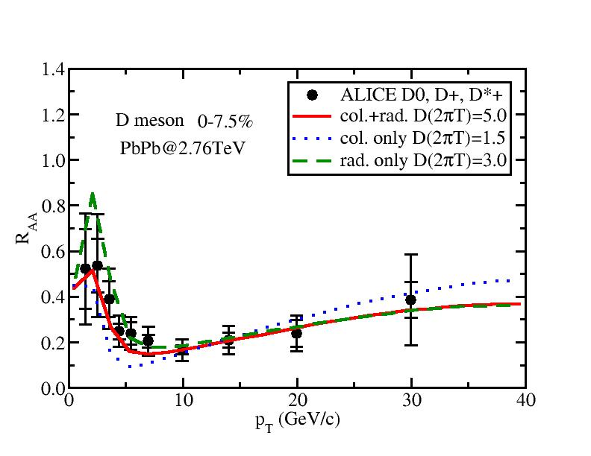
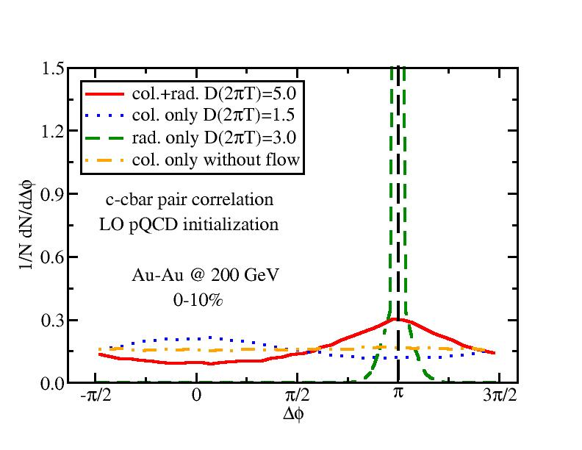
Angular De-correlation of CCbar
Though each energy loss mechanism alone can fit R_{AA} to certain accuracy, they display very different behaviors of angular de-correlation.
Pure radiative energy loss does not influence the angular correlation significantly; pure collisional leads to peak at collinear distribution because of the QGP flow.

Slide 21
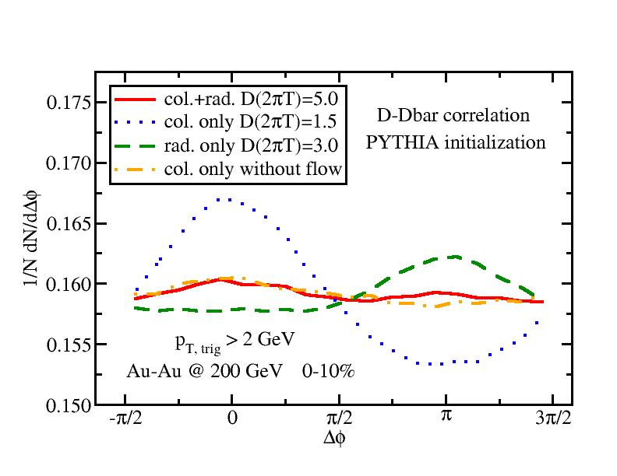
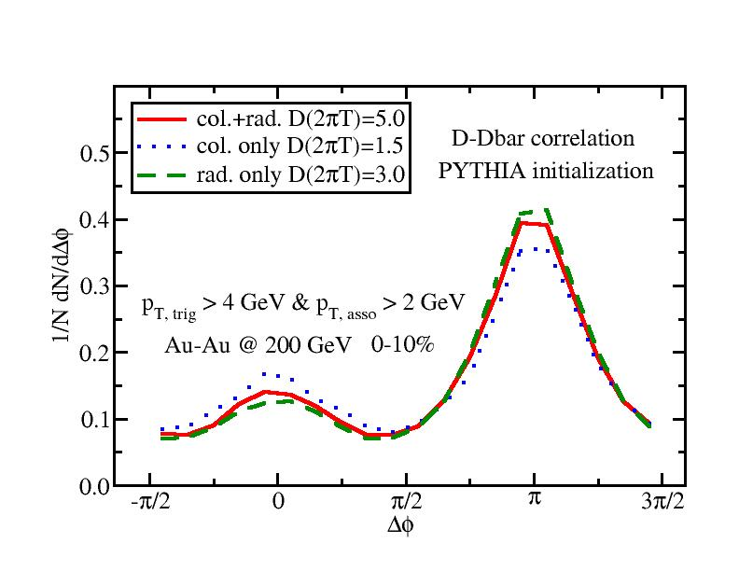
More Realistic Analysis
PYTHIA simulation for heavy quark initial production
Within each event, loop each D with all Dbar’s
Low p_{T} cuts: similar shape as ccbar pairs except on top of a large background of uncorrelated D and Dbar’s
Large low p_{T} cuts: smaller difference between various mechanisms

Slide 22
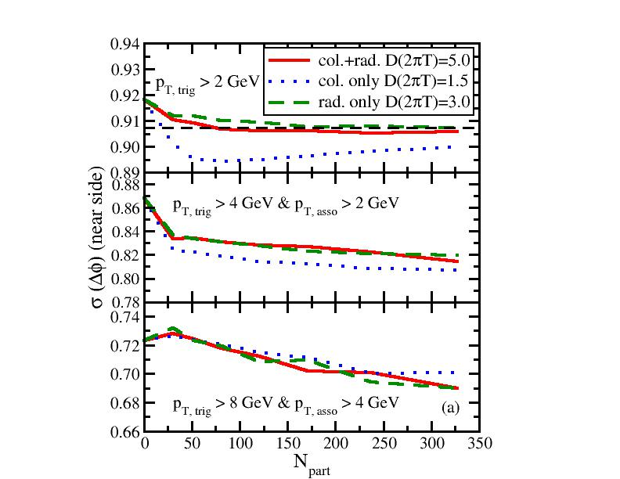
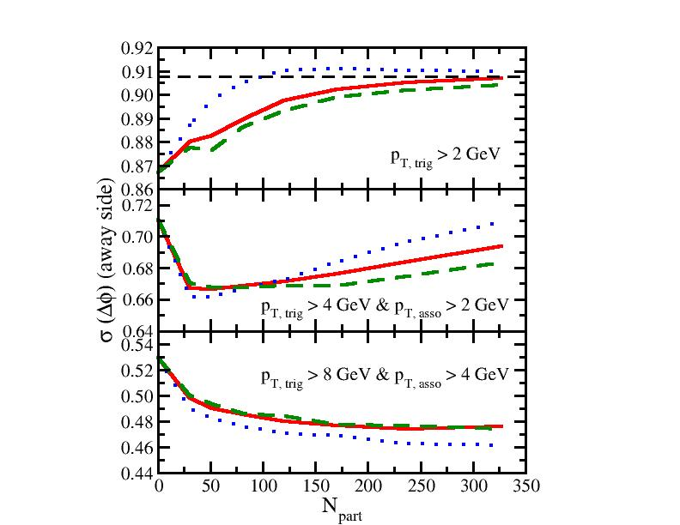
Near / Away Side Variances
Away side at medium p_{T}: non-monotonic behavior – longitudinal energy loss vs. transverse momentum broadening.

Slide 23
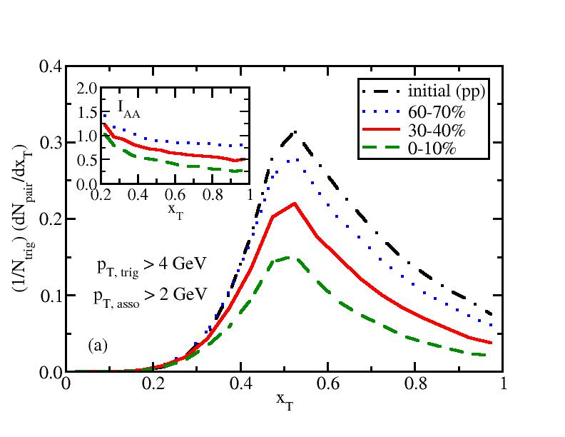
Momentum Imbalance of D mesons
Momentum imbalance: x_{T} = p_{T,asso} / p_{T,trig}
Energy loss -> less pairs of D-Dbar within p_{T} cuts in more central collisions due to energy loss
Energy loss -> the peak of x_{T} shifts to the left

Slide 24
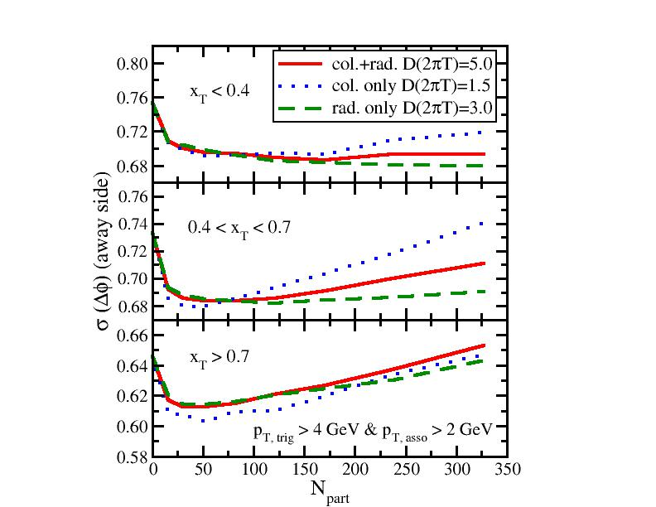
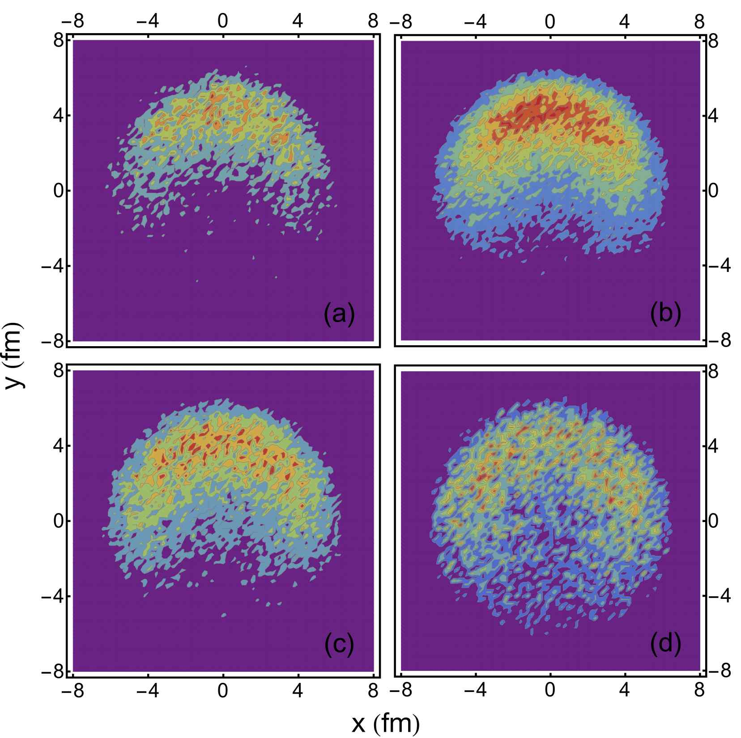
Probe Different Regions of QGP
Density distribution of the initial ccbar production points: (a) x_{T} ∈ [0.2, 0.4], (b) x_{T} ∈ [0.4, 0.6], (c) x_{T} ∈ [0.6, 0.8], and (d) x_{T} ∈ [0.8, 1.0].
The away side variance of angular correlation functions in different x_{T} regions: longitudinal energy loss vs. transverse momentum broadening.

Slide 25
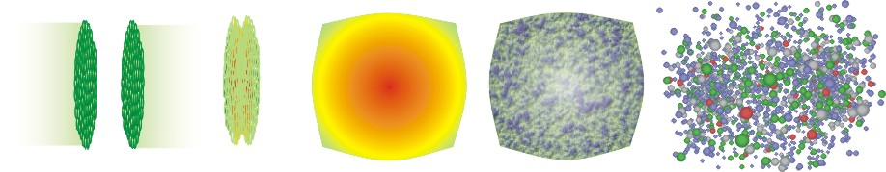
Summary
hadronic phase
and freeze-out
QGP and
hydrodynamic expansion
initial state
pre-equilibrium
hadronization
Bulk Matter: Glb or KLN (2+1)-d viscous Cooper-Frye
UrQMD
Heavy Flavor: Glauber for x Langevin Hybrid model
pQCD for p col.+rad. frag.+coal.
Provided descriptions of heavy meson suppression consistent with most of the data at both RHIC and LHC
Discussed two-particle correlation functions of heavy mesons which may provide better insights of heavy flavor dynamics in heavy-ion collisions

Slide 26
Thank you!

Slide 27
Charm Quark Evolution inside the QGP
Generation of QGP medium: 2D viscous hydro from OSU group (thanks to Qiu, Shen, Song, and Heinz)
Initialization of heavy quarks: MC-Glauber for position space and pQCD calculation for momentum space
Simulation of heavy quark evolution: the improved Langevin algorithm in the local rest frame of the medium
Hadronization and hadronic scattering (discuss later)
D=5/(2πT), i.e., qhat around 3 GeV²/fm at initial temperature (around 350~400 MeV)
outside the medium
(below T_{c})
hadronize and hadronic scattering

Slide 28
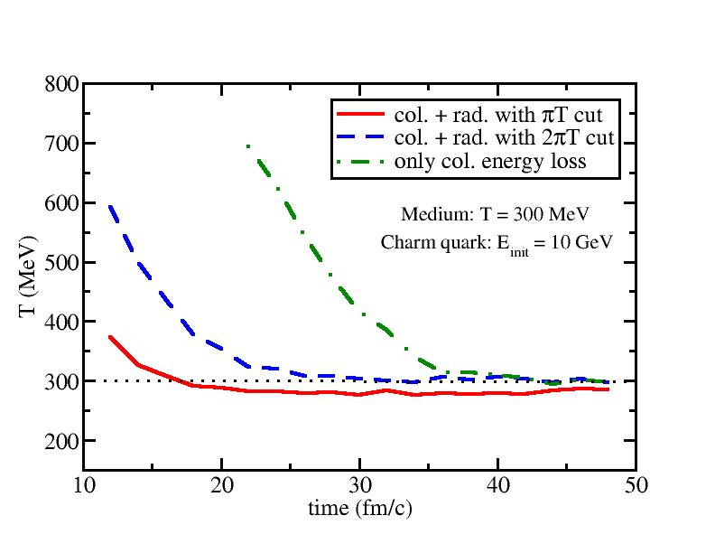
Check of Detail Balance
Modified Langevin Equation:
Gluon radiation only, may break the detail balance
Cut off gluon radiation at low energies where collisional energy loss dominates and detail balance is preserved.
Large enough cut reproduces charm quark thermalization behavior.
More rigorous solution: include gluon absorption term into the higher-twist formalism directly and recalculate term.

Slide 29
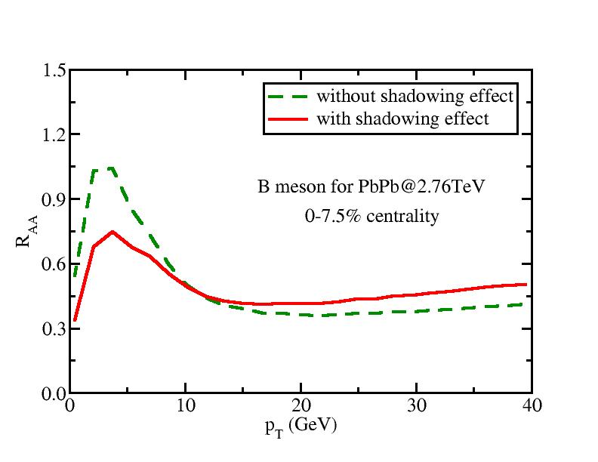
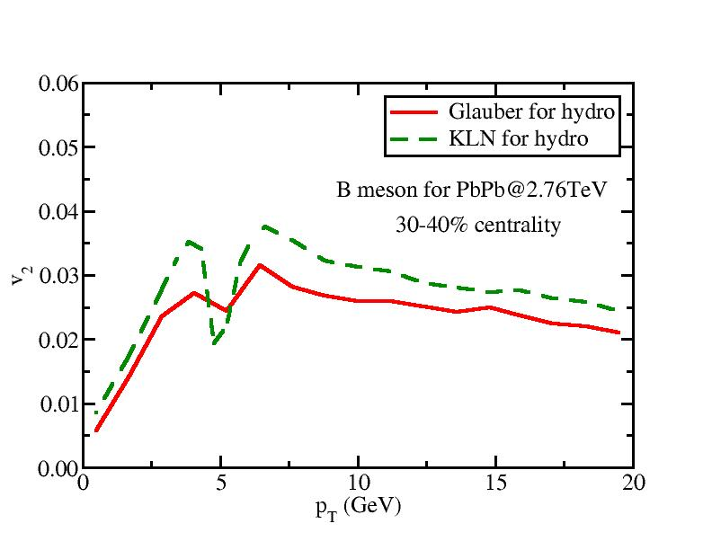
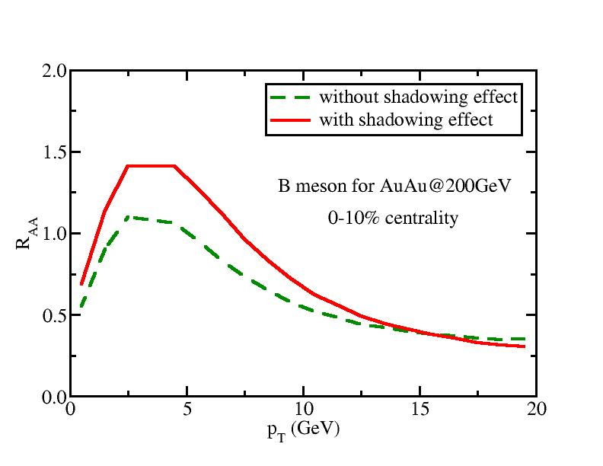
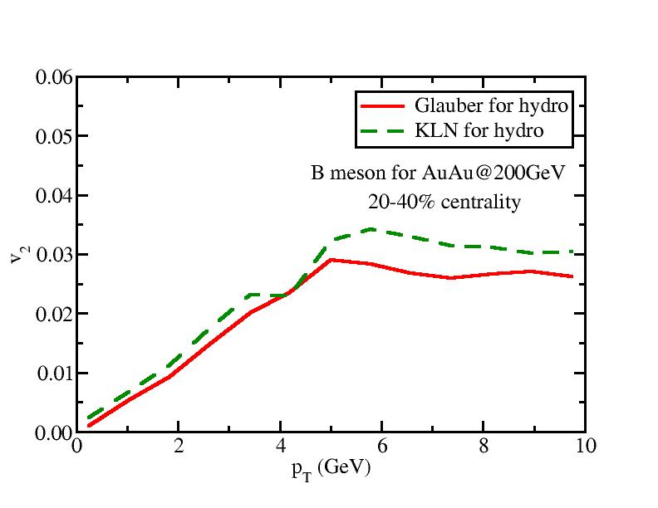
Prediction for B Meson Measurements
The shadowing effect for b-quark is not as significant as c-quark, but still non-negligible. “Anti-shadowing” at RHIC energy.

Slide 30
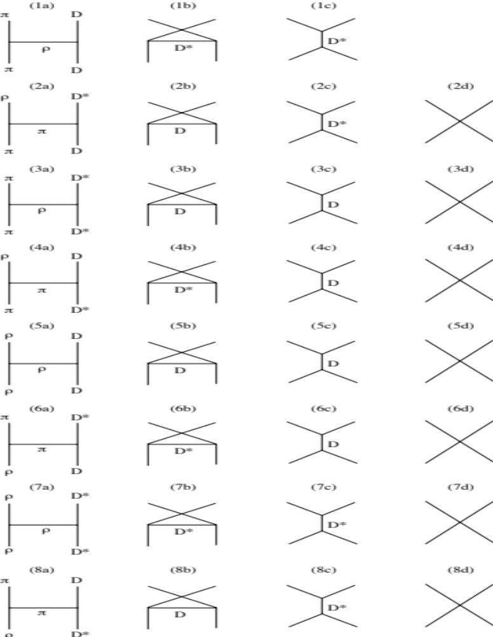

Slide 31
Near / Away Side Variances
Near side at low p_{T}: asymptotic behavior towards uniform distribution π/√12.
Away side at medium p_{T}: non-monotonic behavior – competition between longitudinal energy loss and transverse momentum broadening.

Slide 32
